Slide 1
Churn Prediction on Big Data
Balram
Pooran
Rohan

Slide 2
Motivation
5% increase in customer retention yields as much as 25-95% increase in profitability1
The success rate of selling to a customer you already have is 60-70%, while the success rate of selling to a new customer is 5-20%2
Cost of acquisition of new customer acquisition is 4-10 times the average cost of retaining existing customer3
Usually, 80% of revenue comes from the top 20% customers4
1 https://www.businessnewsdaily.com/16027-customer-retention-rate.html 2. https://github.com/sahidul-shaikh/telecom-churn-case-study
3. https://www.linkedin.com/pulse/what-cost-customer-acquisition-vs-retention-ian-kingwil
4. https://www.investopedia.com/terms/1/80-20-rule.asp

Slide 3
Problems we are trying to solve
Alert CS team ahead of churn ( within 30/60/90 days)
To save high value accounts via calls
To save low value accounts via emails
Recommend steps to avoid churn
Bad service – offer discounts
Low usage – recommend personalized content
Recommend steps to win back churned accounts

Slide 4
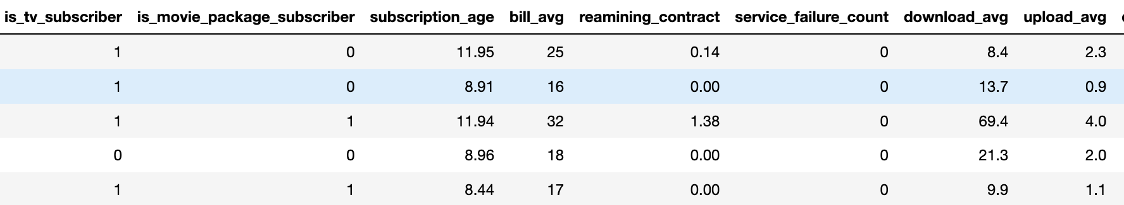
Dataset Used
Internet Service Provider Data
Info:
Records : 7 Million records
Columns : 10

Slide 5
Customer Insight
1400 | 19235
1096 | 28644
0
We have lost the red ones
We should not use the green ones
1
>95 percentile
High Paying Customers
Rest of the customers

Slide 6



Current Pipeline
Data Ingestion
Data Processing
Model Training
Inference
Tools Used

Slide 7
Benchmarks
Full run: Standard: ~43 secs
Intel Optimized: ~10.7. (4X faster)

Slide 8
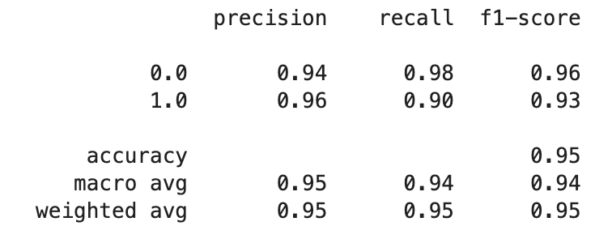
Model Performance

Slide 9
Thanks
Link: https://github.com/balrammirani/BuildersCamp_Hack23

